Slide 1

MovAI - Movie Suggestion Tool
Best way to find your next favorite movie
csc648-spring23-04-team02

Slide 2


Built on React and Django
Combines the power of two popular frameworks
Enables quick and efficient user experience
Provides real-time updates on suggestions
Customizable layout and options for convenient usage

Slide 3
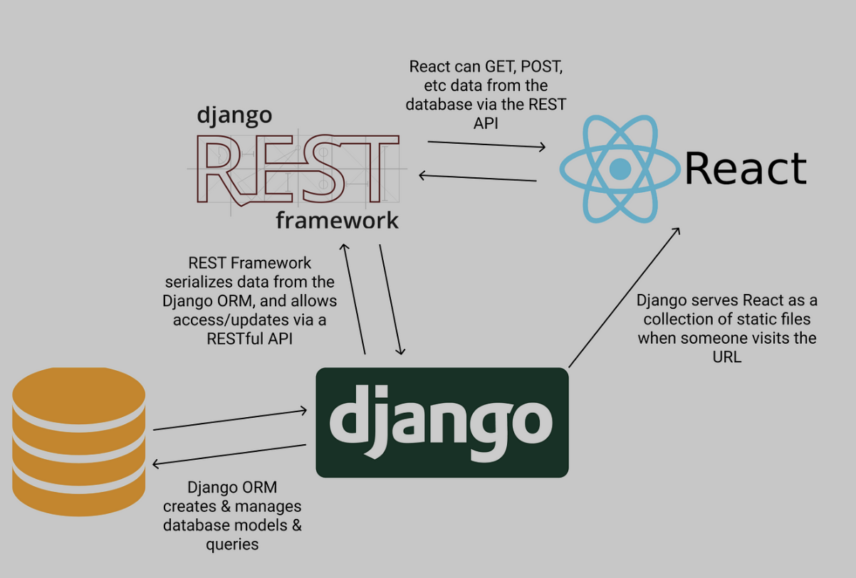
Rest Framework
Serialization
Authentication
Permissions
Testing
Debugging
Viewsets
Routers

Slide 4
MovAI Flow
User can rate a movie thumbs-up or thumbs-down to improve future recommendations.
View Recommendation History
Login
Yes
The AI will generate recommendations based on selected options as well as rating history.
Have account?
Start
Home Page
Get Started
Pick Genres, length, year, age rating
Get Recommendations
No
Signup
User can remove previously given ratings.
View Past Ratings

Slide 5
MovAI Key Points
Cutting-Edge AI Technology: MovAI is powered by GPT-3, an advanced language model developed by OpenAI, providing state-of-the-art natural language understanding and generation capabilities.
Seamless User Experience: With its intuitive interface, MovAI offers a user-friendly experience, making it effortless for users to input their preferences and receive instant movie recommendations.
Wide Range of Movie Selection: MovAI has a vast and constantly updated database of movies, ensuring a comprehensive collection of titles across various genres, languages, and time periods.
Multi-Dimensional Analysis: Unlike other movie recommendation tools, MovAI considers multiple dimensions of user preferences, including genres, actors, directors, plot elements, and more, resulting in highly accurate and relevant recommendations.

Slide 6
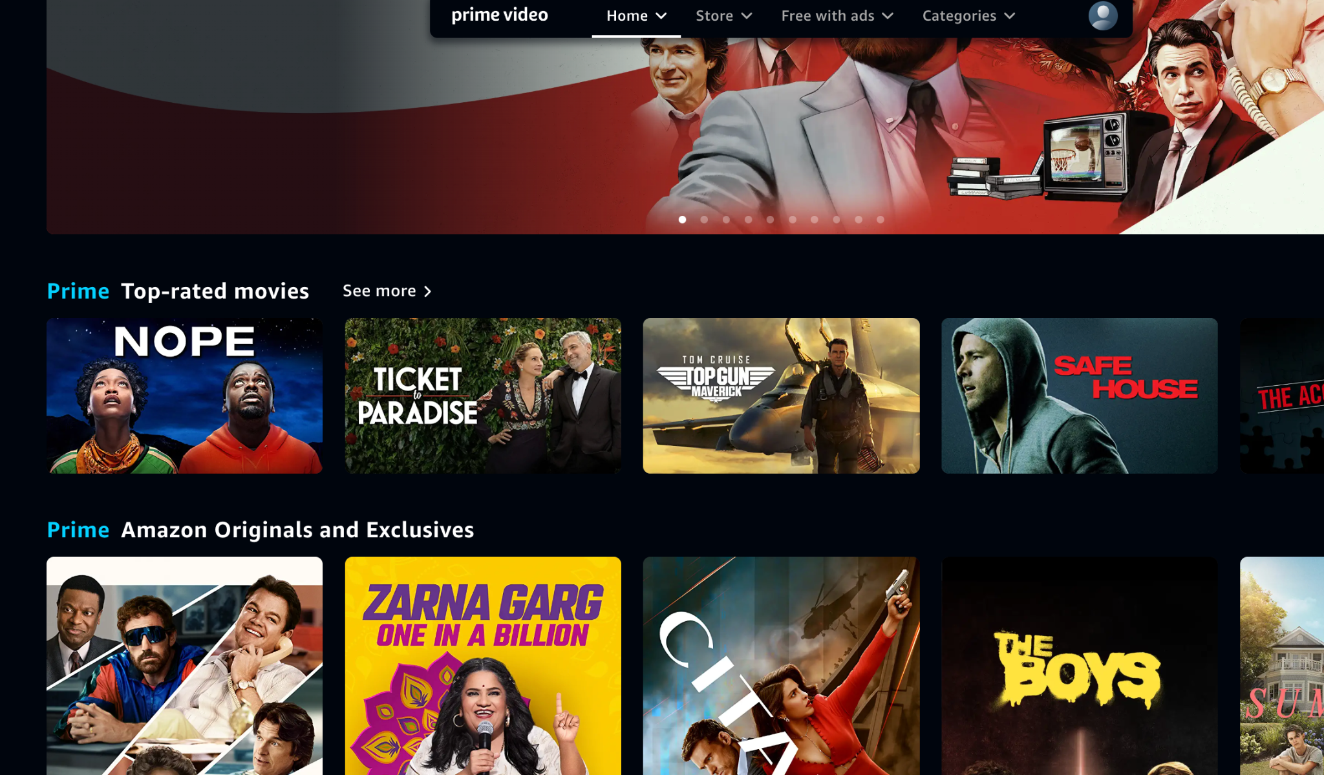
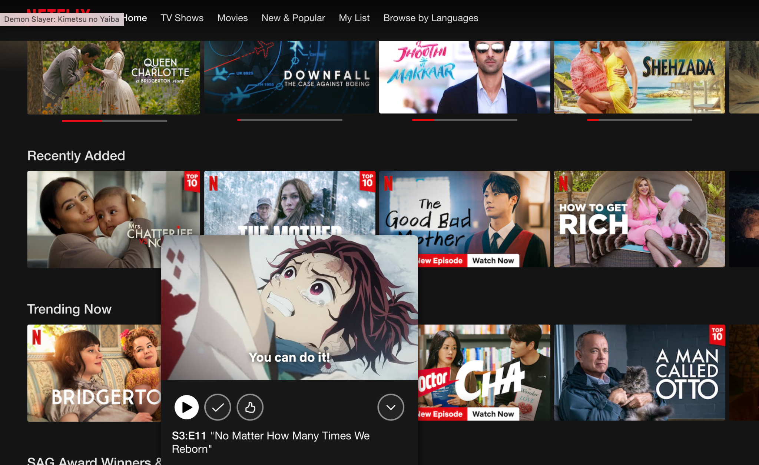
Competitive Analysis

Slide 7







UX Principles

Slide 8
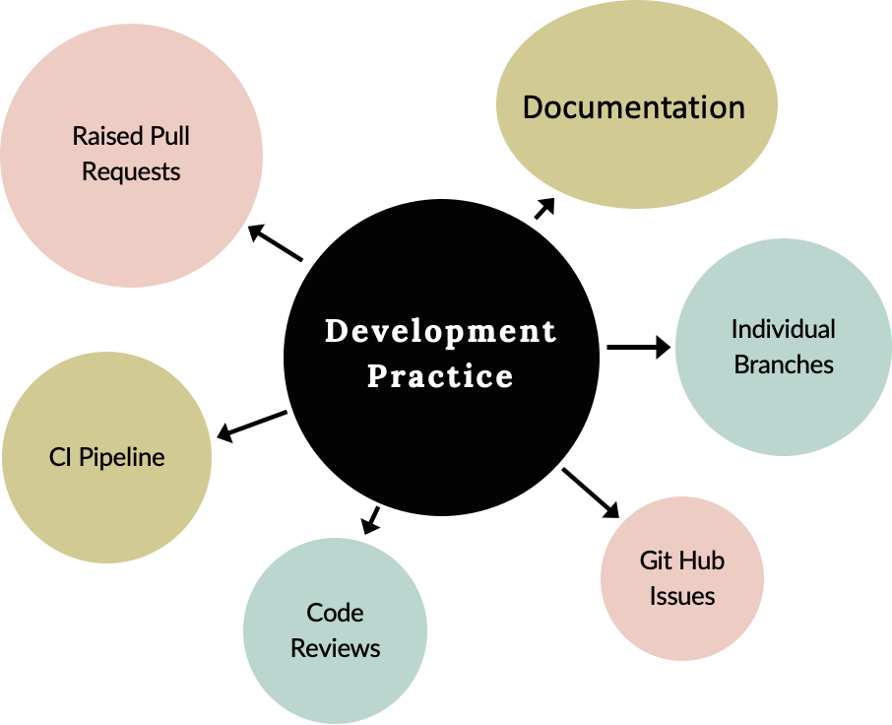

Slide 9
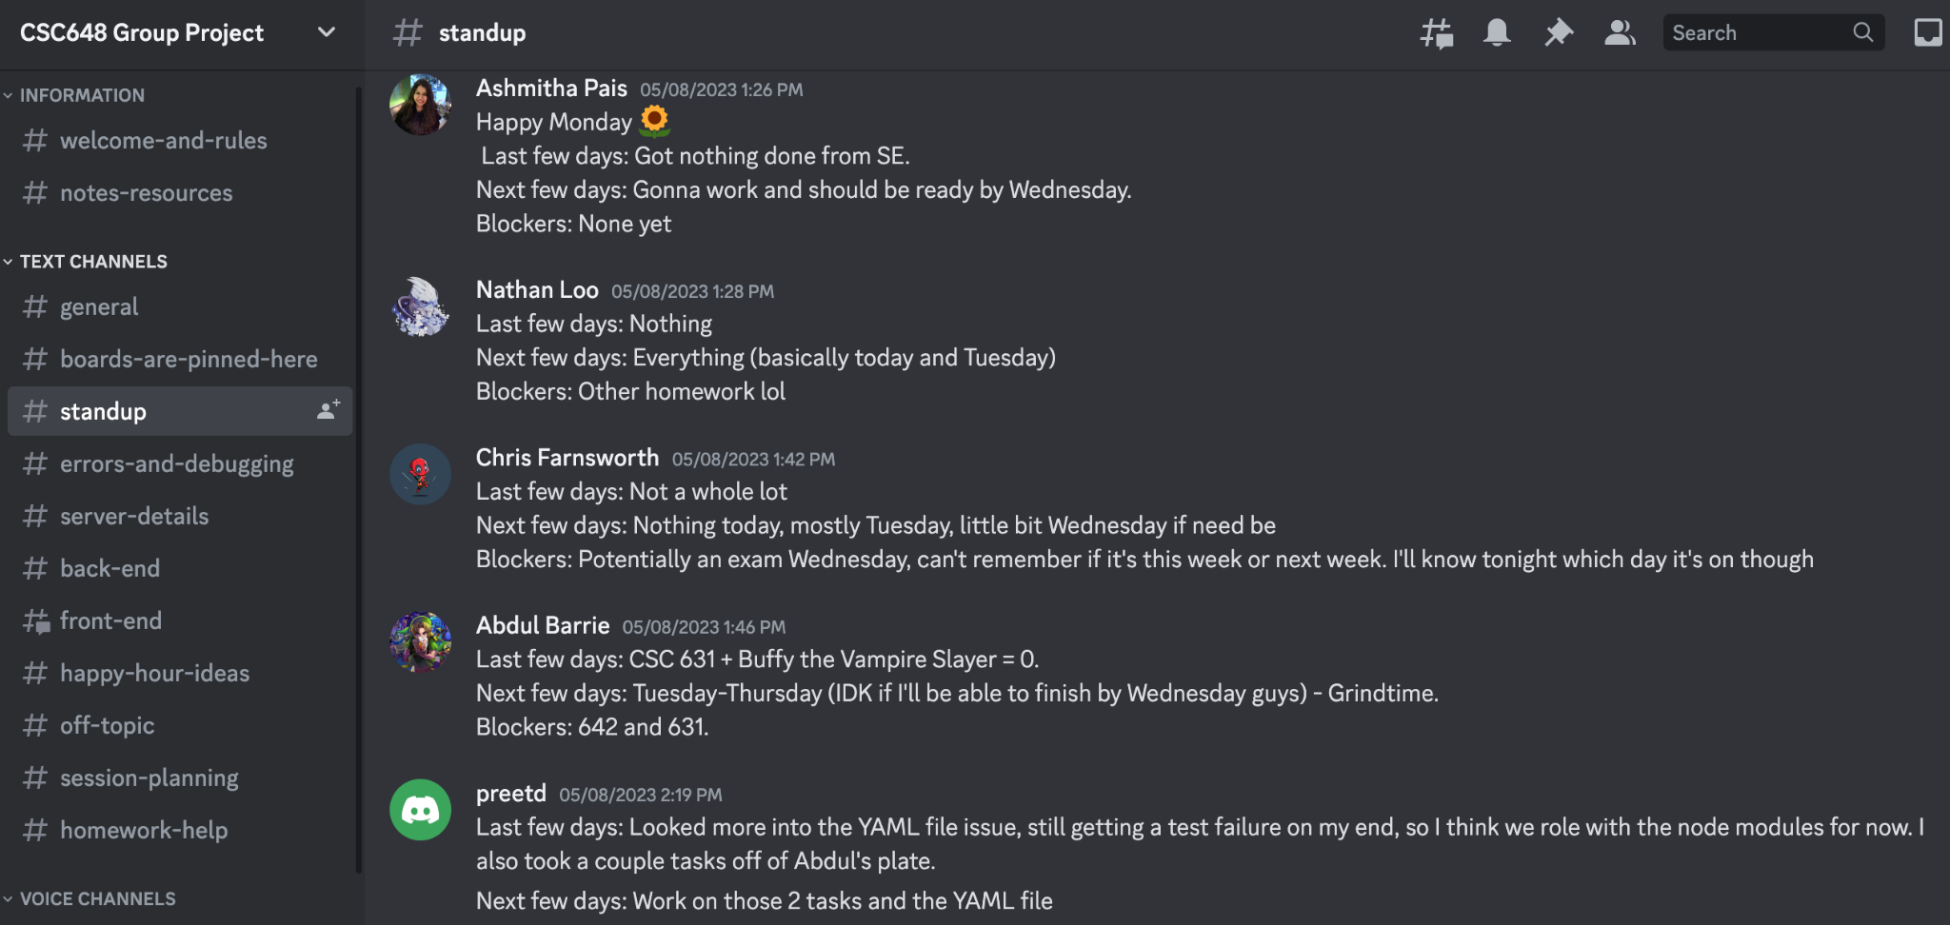
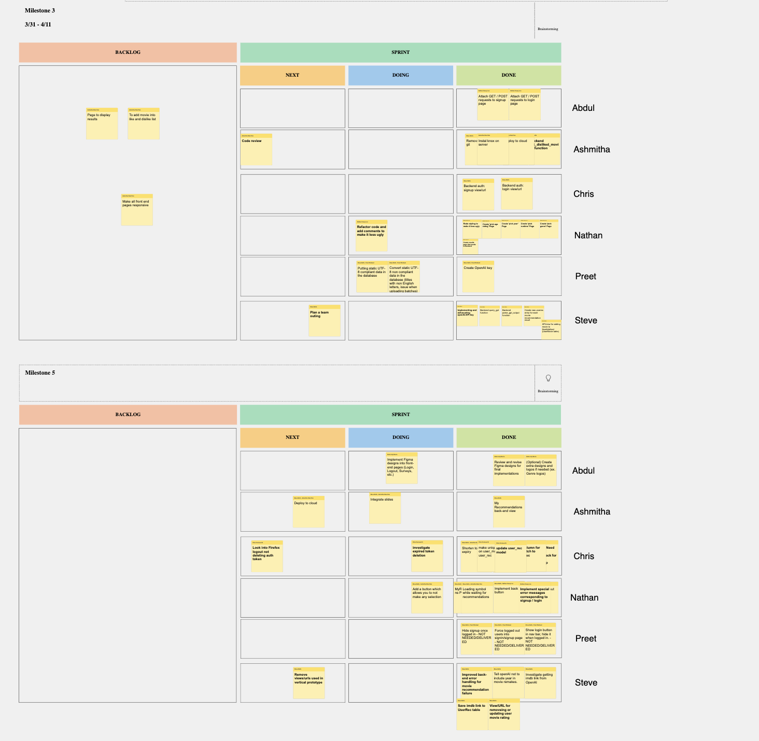
Team Building
Microsoft whiteboard
Discord
Team Meetings

Slide 10
Team 2
Team Lead | Ashmitha Pais
Scrum Master | Steve Betts
Github Lead / Back-End | Preet Dhaliwal
Back-End Lead | Chris Farnsworth
Front-End Lead | Abdul Barrie
Product Owner / Front-End | Nathan Loo

